Slide 1
SECURE file transfer system
Presentation by Mohammed Amaan Shariff Shaik

Slide 2
aim
The aim of this project is to implement a utility to transfer files securely while maintaining their confidentiality and integrity.

Slide 3
Problem/need
Public key encryption is used for data encryption to prevent key distribution problems.
It bottlenecks the performance while encrypting large files.
Symmetric key encryption is far more efficient in this case but it difficult to maintain the key secrecy

Slide 4
Approach
Three hybrid encryption techniques:
symmetric AES algorithm used to encrypt files
asymmetric RSA used to encrypt AES key
HMAC to ensure authenticity

Slide 5
What is hmac?
HMAC stands for Hash-based Message Authentication Code
It's a message authentication code obtained by running a cryptographic hash function (like MD5, SHA1, and SHA256) over the data (to be authenticated) and a shared secret key.
HMACs are almost similar to digital signatures, the main difference is that digital signatures use asymmetric keys, while HMACs use symmetric keys.

Slide 6
Client functionality
Generate a 32-byte key using a Random Number Generator which is used as the AES key.
Encrypt the file using above generated random key with AES 256 bit Encryption.
Encrypt the 32 bit AES key using the Server’s public key.
A 16-byte key is also generated and HMAC of the file is calculated.

Slide 7
Server functionality
It generates public and private keys using RSA algorithm.
extracts first 40 bytes as the original file hash , the encrypted AES key and the encrypted HMAC key.
Server uses its private key to decrypt the encrypted AES symmetric key and HMAC key.
To integrate validity, the extracted HMAC is compared with the HMAC of the received file using the extracted HMAC key.

Slide 8
Advantages
Overall Encryption run is Simple.
AES is used to encrypt sent data has high encryption speeds
low computational requirements
provides high system security.

Slide 9
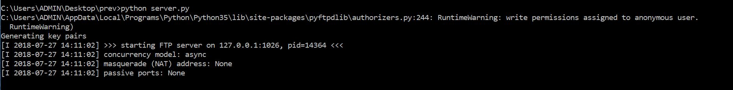
Initial server output

Slide 10
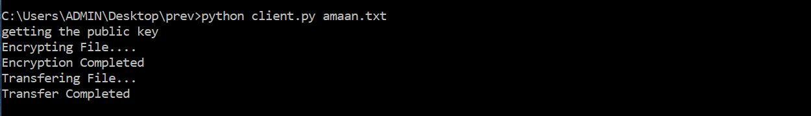
Client output

Slide 11
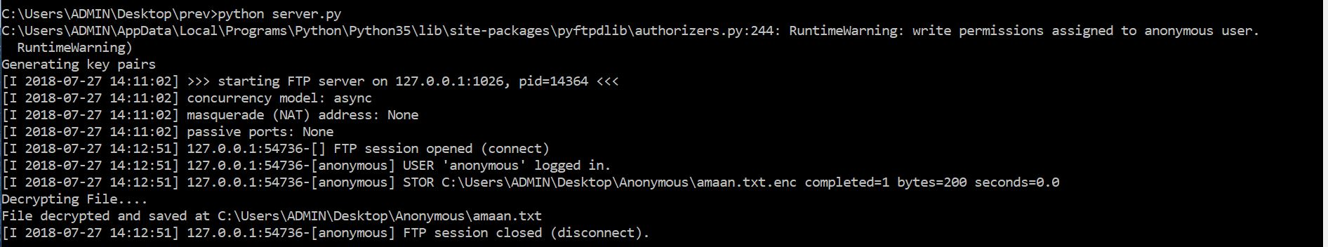
Server output after receiving file

